Slide 1
Employee Performance Analysis using Excel
PRESENTED BY : S. SHALINI
REGISTER NO : 2213331042143
DEPARTMENT : COMMERCE
COLLEGE : BHARATHI WOMEN’S COLLEGE

Slide 2
PROJECT TITLE
EMPLOYEE PERFORMANCE ANALYSIS USING EXCEL

Slide 3
AGENDA
Introduction
Problem Statement
Project Overview
End users
Our solution and Proposition
Dataset Description
Modelling Approach
Results and Discussion
Conclusion

Slide 4
INTRODUCTION
In today’s presentation , we will go through the process of creating an Excel Sheet designed for employee performance analysis ( Employee Performance Scoreboard ) . This tool was developed to streamline the evaluation process , allowing for a more efficient and data-driven approach to assessing employee performance.
we’ll see how to structure a data, by utilization of Excel’s powerful functions and features, and to transform raw data into actionable insights. By the end of this presentation, you’ll have a clear understanding of the steps involved in building this analysis tool, from data input and organization to the final analysis and visualization. This approach not only simplifies the performance review process but also provides a solid foundation for making informed HR decisions.

Slide 5
PROBLEM STATEMENT
In a company, we need the accurate performance of employees to motivate good performers, provide incentives to best performers and to train employees in need.
The main challenge here was managing a large dataset where only performance-related information was needed. To address this, I filtered out irrelevant data, focusing solely on key performance metrics.
This helped streamline the analysis process, ensuring that only the most pertinent information was considered. Additionally, creating a performance scoreboard was essential for evaluating employee contributions accurately.
To achieve this, I utilized Excel’s IF formula, which allowed for the automatic calculation of performance scores based on specific criteria.
This approach simplified the analysis, making it both efficient and precise, ultimately providing clear insights into employee performance.

Slide 6
PROJECT OVERVIEW
OBJECTIVE
SOLUTIONS IMPLEMENTED
OUTCOME
CHALLENGES
Develop an Excel based tool for effective employee performance analysis.
Large dataset with non-performance-related data.
Need for an automated performance scoreboard.
Data filtering : Removed irrelevant data to focus on key performance metrics.
Scoreboard creation : Used the IF formula to automate performance scoring.
Streamlined analysis process.
Accurate, objective performance evaluations.
Enhanced data-driven decision-making for HR.

Slide 7
END USERS
HR Managers :
Oversee performance evaluations and implement HR strategies.
Team Leaders / Supervisors :
Assess and review team member performance.
Department Heads :
Analyse overall departmental performance and identify areas for improvement.
Executives :
Employees :
Make strategic decisions based on performance data.
Receive feedback and performance scores that impact their career development.

Slide 8
OUR SOLUTION AND PROPOSITION
FILTERING :
To filter unwanted data from the data sheet.
FORMULA – IF :
To make performance scoreboard by giving numerical value.
PIVOT TABLE :
To represent the performance scoreboard from various titles.
CLUSTER COLUMN CHART :
To represent the pivot table in a graphical way.
TRENDLINE :
To show the trend line of performance score.
SLICER :
To filter Performance Score and Performance Scoreboard.

Slide 9
DATASET DESCRIPTION
Employee Data Set – Kaggle
Total – 26 Features
Features Utilized – 13 ; Created - 1
Features Description :
Emp ID: identification number of employees.
First name: first name of the employees.
Last name: last name of the employees.
Title: job title of the employees.
Business unit: business unit of the employees.
Employee status: working status of the employees.
Employee type: full time / part time
Employee classification type: full time / part time / temporary
Department type: department type of the employees.
Division: division of the department of the employees.
Job function description: job function description of the employee.
Performance score: performance score of the employees (fully meets/ exceeds/ need improvement/ PIP)
Current employee rating: numerical rating for current employees.
Performance scoreboard: performance scoreboard based on the performance score of the employees in numericalvalue.

Slide 10
MODELLING APPROACH
Data Collection : Various data being collected for the purpose of creating performance scoreboard of employees.
Data filteration : In this step, we filter out the data we need by eliminating the data that is not related to the performance of the employee. Drag and select employee type, employee classification type. Then click on sort & filter – filter. Now filter it by full time in employee type and full time, part time in employee classification type.
Creation of performance scoreboard : Now, create performance scoreboard by using IF formula. i.e., =if(l4=”fully meets”,2,if(l4=“exceeds”,3,1)) which means, fully meets = 2 ; exceeds = 3 ; others = 1 i.e., need improvement and PIP.
Creation of pivot table : Now, create pivot table by selecting all data we’ve made (Ctrl+A) – insert – pivot table. After clicking on pivot table, select the essential data you need in pivot table : row labels – title ; column label – performance score ; value label – performance scoreboard ; filter – department type( admin & sales ).
Creation of chart : Select pivot table and then click on any chart you want or click on recommended chart.
Slicer : Double click on pivot chart, then click on Insert Slicer at the upper corner. Then select Performance Score & Performance Scoreboard.
Trend line : Click on the chart then select the + icon on the right side. Then, enter trend line and click fully meets and exceeds.

Slide 11
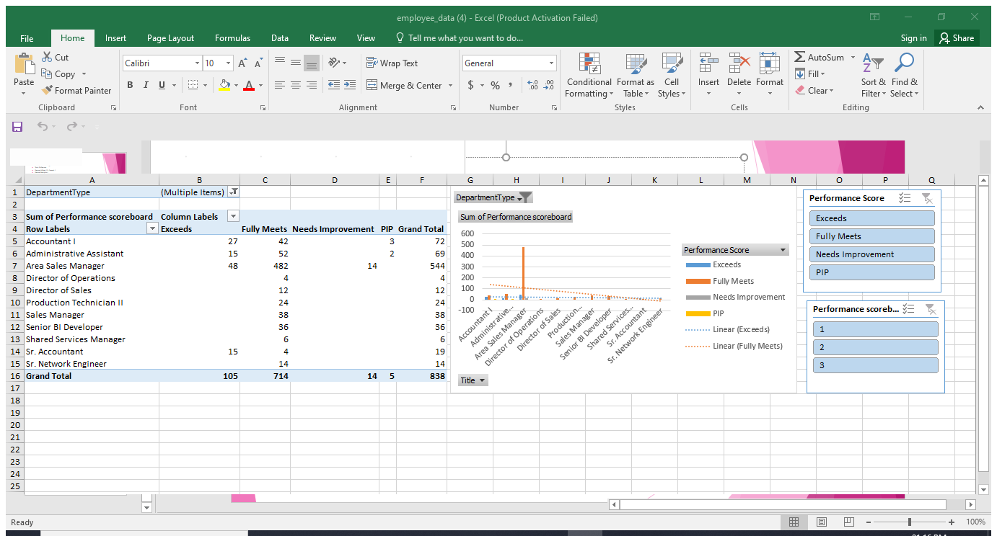
RESULTS AND DISCUSSION
RESULTS :
Filtering irrelevant data focused the analysis on key performance metrics, leading to a more accurate evaluation. The IF formula automated performance scoring, providing objective and consistent results. Trend lines in charts revealed clear patterns in employee performance over time, aiding in identifying high performers and areas for improvement. Slicers enabled dynamic filtering, allowing users to view data by specific criteria such as department or role.
DISCUSSION :
the streamlined approach improved data revealed and accuracy. Automated scoring and visual trends facilitated better performance insights. Interactive slicers enhanced usability, making the tool more effective for detailed and segmented analysis. Overall, the tool supported informed HR decisions and efficient performance management.

Slide 12
CONCLUSION
The Excel-based employee performance analysis tool successfully streamlined the evaluation process by filtering relevant data and automating scoring with the IF formula. Trend lines and slicers enhanced data analytics, revealing performance patterns and allowing dynamic data segmentation. This tool simplifies performance reviews, supports objective decision-making, and provides actionable insights, ultimately contributing to more effective performance management and better-informed HR decisions.

Slide 13
THANK YOU ALL
FOR GOING THROUGH THIS PRESENTATION…

